Slide 1
MySQL Conceptual Architecture
EECS 4314
Ante Pimentel
Dusan Birtasevic
Francis Okoyo
Hashim Al-Helli
Richard Van

Slide 2
What is MySQL?
MySQL is an open source RDBMS (Relational Database Management System).
It is widely used by many companies like amazon,Facebook,etc to manage their data.

Slide 3
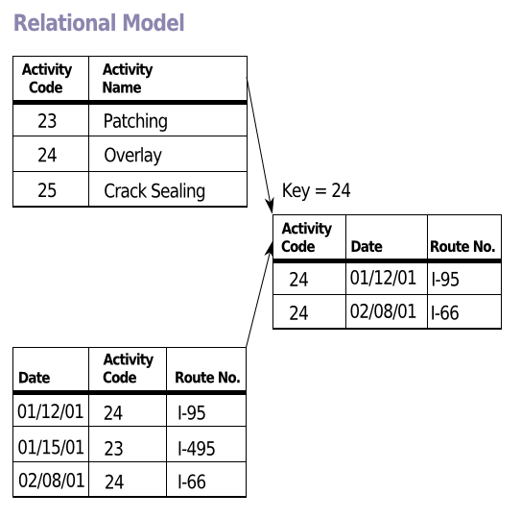
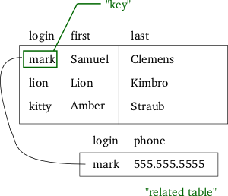
What an RDBMS does
Manages data using the Relational model.
This model of database management is an approach that uses a structure and language consistent with first-order predicate logic.
This represents data in terms of tuples which are grouped into relations.

Slide 4
Why use MySQL?
MySQL is an open source meaning lower cost to operate.
Cross Platform Support.
Fast Performance.
Scalability.

Slide 5
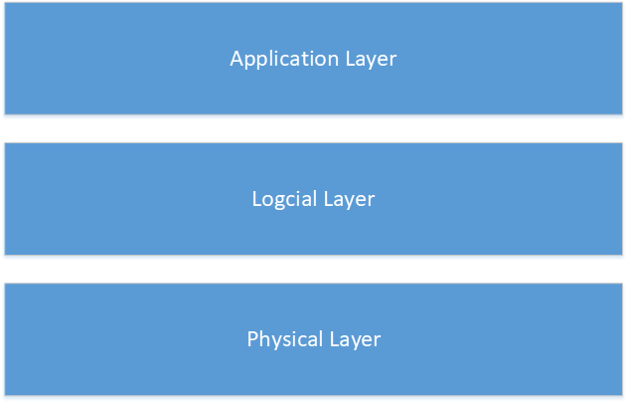
General RDBMS Architecture
Notes:
Application Layer
The application layer provides the means interface which the client can interact with the database server.
Logical Layer
It contains the main components of the database system.
Physical Layer
Provides access to the disk which is used as a secondary storage and accessed by the storage manager. Data such as user data files, log files,indices, and structure of the database are all stored in the physical disk.

Slide 6
Derivation Process
Went over documentations and articles regarding the conceptual architecture.
Found out that most documentation and articles contains the same information with little change.
Our derivation process is based on the references that we used to come up with the conceptual architecture.

Slide 7
MySQL Application Layer

Slide 8
Top layer of the architecture; the layer that enable users to interact with the MySQL database system.
Consists of 3 sublayers: Administrative interface and utilities, Client interface and utilities, Query interface.
Administrative interface and utilities
Used by admins for management of the system. Things like server shutdown, creation or termination of databases, managing or transferring databases. These users have complete control over the database.
Client interface and utilities
Used by clients. interact with MySQL through the client interface and utilities like MySQL API’s.
The API’s send queries to the server as tokens.
Query interface
(naïve) users interact with MySQL through the query interface, these users issue SQL statements (commands/queries) to the server and examine the results.

Slide 9
MySQL Logical Layer

Slide 10
Data received from the application layer is handled by this layer. Similar to that of the general RDBMS logical layer, the MySQL logical layer consists of 4 sublayers.
Query processor
Based on a pipe and filter type architecture. Processes the majority of the interactions between the users and the system.
Transaction management
consists of the Transaction Manager, and Concurrency-Control Manager which ensure atomical and independent execution of transactions.
Recovery management
Restores the system back to its normal state in the event of a crash.
Storage management
Sends information to the Storage layer.
note that in general, the design of the logical layer in RDBMS vary from build to build.

Slide 11
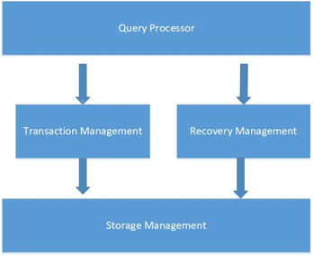

Slide 12
MySQL Physical Layer
The final layer of this architecture contains storage engines which are responsible for storing and retrieving data. The main difference between the physical layer of the MySQL architecture and that of the general is its pluggable engine architecture. This allows storage engine to be loaded and unloaded from servers.

Slide 13
MySQL Logical Components

Slide 14
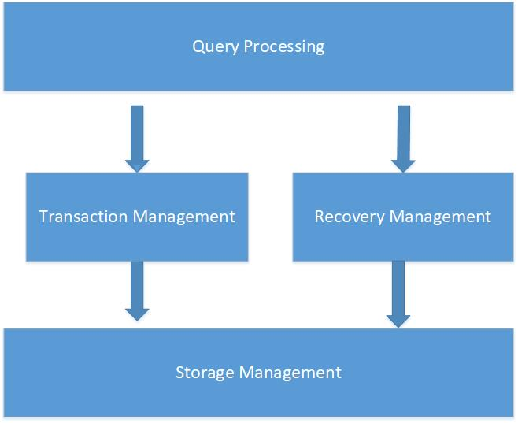

Slide 15
Explanation
Query Processing:
Parsess and optimizes the SQL command.
Transaction management:
Makes sure that the command is logged and is executed using the atomic principle from ACID principle (Atomic,consistent,Isolated,Durable).
Atomic principle means that the transaction can either occur or not occur so no transaction is done partially.
Responsible for solving deadLocks in the database.
Recovery Manager
Restore the database to its last stable state.
Notes:
The Query Processor follows the pipeline architecture output of one component is passed as the input of another component .

Slide 16
Explanation
Query Processing:
Consist of , Embedded DML (Data Manipulation Language) precompiler, DDL (Data Definition Language) compiler, Query parser, Query preprocessor, Security Integration Manager, Query optimizer, and execution engine.
Transaction management:
Consist of the Transaction Manager, and Concurrency-Control Manager.
Recovery Manager
Consist of Log Manager, and Recover Manager.
Storage Management
The storage management layer contains Storage Manager, Buffer Manager, and Resource Manager.
Notes:
The Query Processor follows the pipeline architecture output of one component is passed as the input of another component .

Slide 17
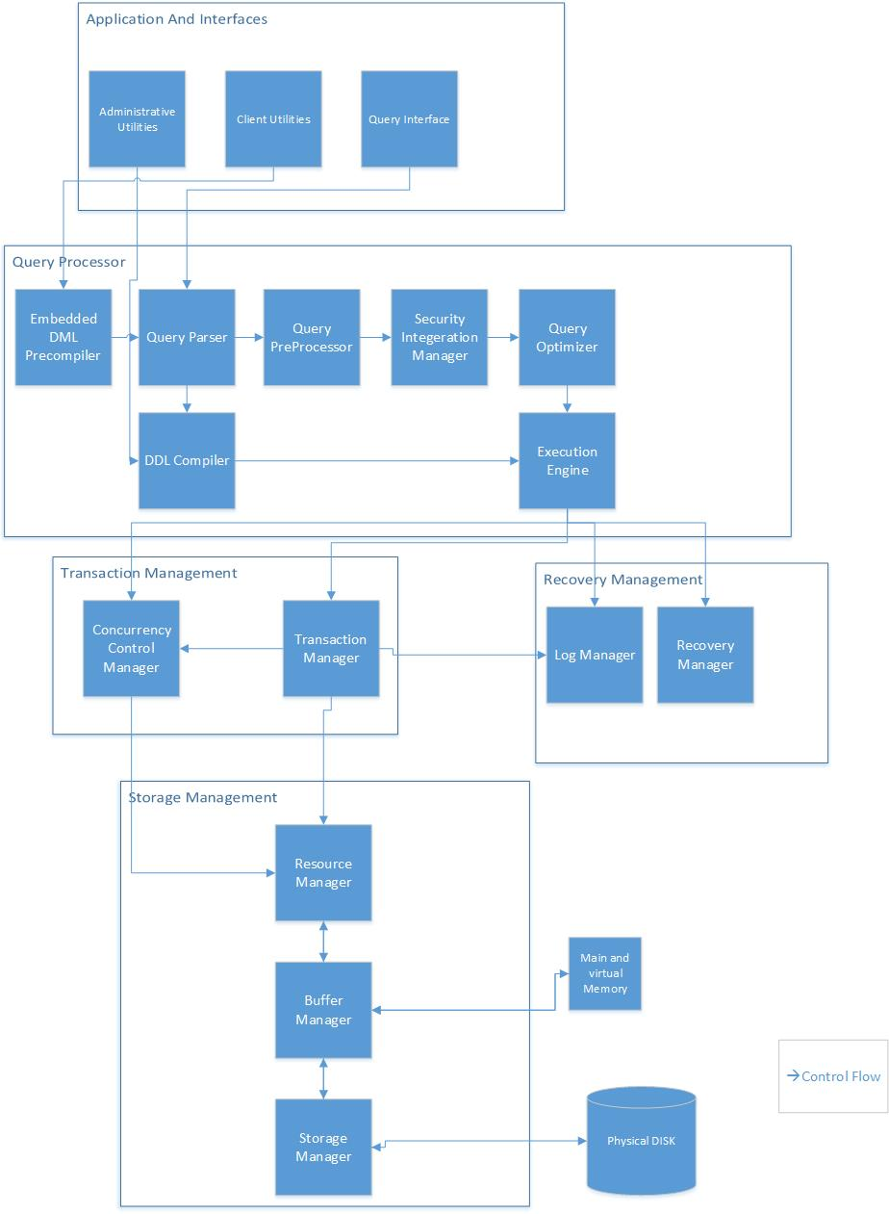

Slide 18
System Evolution

Slide 19
Humble Beginnings
MySQL was created by a small Swedish company called MySQL AB.
The first version of it was released in 1995 and was initially created for personal use by the company.
As the years passed the company continued to update and add shiny new features to MySQL.

Slide 20
Build history
1996 - 02: basic updates.
2004: R-trees, B-trees, subqueries, prepared statements.
2005: cursors,stored procedures, triggers, views, XA transactions.
2008: Sun microsystems acquired MySQL AB (came with more goodies).
2010: Oracle acquires Sun and hell breaks loose (Monty launches Maria BD).
2010- now: continuous improvements morphing MySQL into what we know today.

Slide 21
Flow

Slide 22
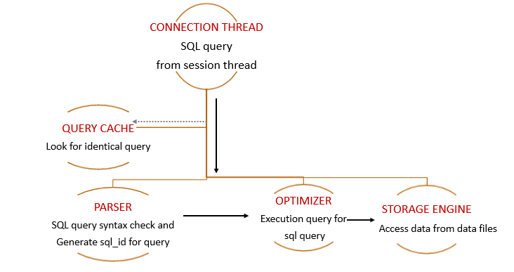
SQL Execution
Notes:
https://lalitvc.wordpress.com/2016/11/03/mysql-architecture-and-components/
SQL statement is submitted.
The query cache is checked to see if identical query was submitted if yes then the results are sent back to the client rather than parsing the statement again.
The parser check for syntax .
Optimizer tries to rewrite the query to execute it in the most efficient way.
The query is then sent to the storage engine InnoDB of myISAM for reading or writing.

Slide 23
Concurrency

Slide 24
Concurrency Overview
Concurrency handled within logical layer
Separate concurrency manager and transaction manager to handle these situations
Where is concurrency needed?
Server connections
Query handling
Notes:
Just listing what

Slide 25
MySQL Server Connections
Every client creates a separate thread on the server
Thread handles client authentication and requests
Includes queries/transactions and other database operations
Multiple clients… what if there are multiple queries at once?
Notes:
Basics from the report. The third point leads to the next slide.
There’s still the question of “how does MySQL handle multiple clients sending queries at the same time?” “Who goes first?”

Slide 26
Simultaneous Queries
Some functionality to handle simultaneous queries found in the storage engine
The way MySQL handles concurrent queries depends on its storage engine
Most storage engines use locks
Clients acquire locks to prevent others from accessing the locked data
Deadlocks are possible but they can be detected and resolved from the transaction manager
Scope of locking depends on storage engine
Some storage engines lock the entire table which may cause performance to drop
Notes:
How simultaneous queries are handled is dependent on the storage engine. MyISAM doesn’t use transactions and queries perform when they are received from the query parser, unless locks are blocking the query from completing. InnoDB does use transactions so queries can be packed into transactions. Locks don’t
The second “Use Case” slide explains locking far more simply than this slide.

Slide 27
Developer Divisions and Implications

Slide 28
General Divisions and Implications
Splitting 2 layered client server architecture into 3 layers.
Helps grow architecture as computing needs change and grow
Rarely, if ever, uses object oriented programming
Code reuse, polymorphism, encapsulation, etc
Removes tight coupling of user interface and data engine in classic approach
Helps with scalability
Facilitates application changes across multiple servers
Performs data operations solely in GUI
Helps convert thin clients to thick clients
Helps with code reuse
Business rules no longer in user-interface
Separation of database from user-interface
Database knowledge in middle layer, not GUI

Slide 29
Application Layer
Separated into 3 main components; Clients, Query Users, Administrators
Maintains data integrity
Clients and query users use utilities and interfaces to communicate with the RDBMS
Clients receive are assigned unique connection thread
Administrators do server maintenance with administrative utilities and interfaces

Slide 30
Logical Layer
Layer divided into subsystems(query processor, recovery, storage, transaction management
Subsystems work together to process requests from application layer
Uses pipe and filter architecture
Makes it easy to understand
Simple to reuse
Allows for specialized analysis(deadlocks,etc)
Supports concurrency(for execution)
Easily maintained and enhanced
May lead to increased complexity
Can cause performance loss if using a lot of processing

Slide 31
Physical Layer
Contains all storage engines for developers
Increased flexibility, may use any storage engine based on needs
Each layer separated within architecture
Implementation details are hidden
API designed for ease of use
No need to manage application coding requirements

Slide 32
Use Case

Slide 33
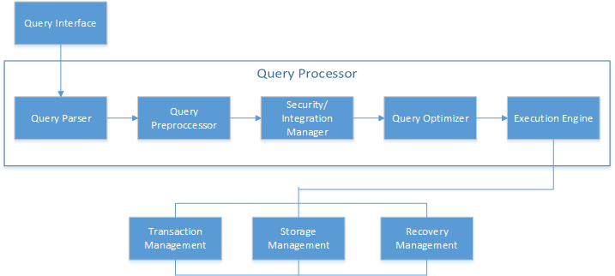
Simplified Flow Diagram
Notes:
Use case: UPDATE
Query comes in from query interface
Goes through Query Parser to Execution Engine
Creates Parse tree, for other components
Checks semantics and syntax
Checks permissions on user
Optimizes query, checks for existing indexes
Create Execution plan
UPDATE is an action that can be committed, so it is a transaction. The Transaction manager is notified. Recovery Manager is notified.

Slide 34
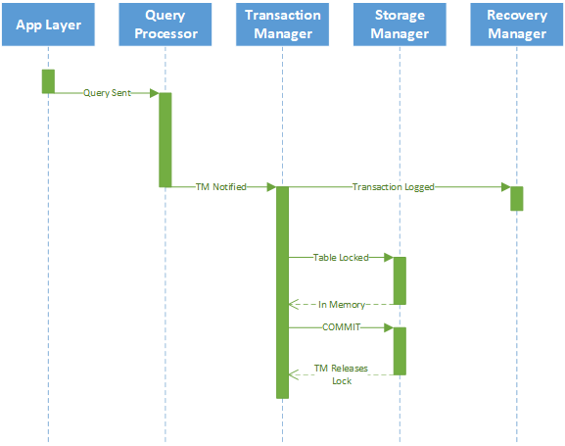
Sequence Diagram
TM notified by Execution Engine
TM logs the transaction
Locks the appropriate table/row
Communicates with SM to load data into memory
Updates table/row
TM releases lock

Slide 35
Lessons Learned
our main challenge in this assignment was organizing information into a format we could understand and explain. This included deciphering and understanding technical jargon specific to RDBMS and MySQL.
Due to conflicting sources, so we needed to synchronize our information and ensure that our findings were consistent with all of our sources.

Slide 36
Questions?

Slide 37
References [1] Nellutia, I. (2017, January 20) MySQL Architecture and Layers. Retrieved from https://qxf2.com/blog/mysql-architecture-and-layers/. [2] Bannon, R., & Chin, A., & Kassam, F., & Roszko, A. (2002, January 27). MySQL Conceptual Architecture. Retrieved from https://s2.smu.edu/~rkotamarti/mysql.pdf. [3] MySQL Architecture (2013, December 22). Retrieved from http://mysqladvice.blogspot.ca/2013/12/mysql-architecture.html. [4] Structure of Database Management System (DBMS). (n.d.). Retrieved from https://www.tutorialcup.com/dbms/structure-of-dbms.htm. [5] MySQL 8.0 Reference Manual. (2017,.October 13). Retrieved from https://dev.mysql.com/doc/refman/8.0/en/. [6] MySQL & mSQL. Retrieved from https://docstore.mik.ua/orelly/linux/sql/ch08_04.htm. [7] Kumar, R. (2016, April 19). Understanding MySQL Architecture. Retrieved from http://www.rathishkumar.in/2016/04/understanding-mysql-architecture.html. [8] Vuong, T. (2013, August 08). MySQL Architecture and Concepts. Retrieved from https://www.slideshare.net/TuyenVuongDinh/mysql-architectures.

